Slide 1



DATAWIZE
DATAWIZE
The ultimate solution for project improvements

Slide 2
DATAWIZE
Index
THE TEAM
THE PROBLEM: INCONSISTENT DATA
THE SOLUTION: STANDARDIZE DATA
THE MARKET: IMPACT AND POTENTIAL
THE COMPETITION: DIFFERENTIATORS
THE FUTURE: ROADMAP AND NEXT STEPS

Slide 3
DATAWIZE
THE TEAM:

Slide 4


DATAWIZE
THE PROBLEM:
Inconsistent Data
CASE X
CASE Y
IMPROVEMENT
IMPROVEMENT
CURRENT * ORGANIZATION
GS/PUI-LA
CURRENT * ORGANIZATION
KT/BC-ZZ
CREATE
CREATE
DEPARTAMENT *
GS/OIS-LA1
DEPARTAMENT *
-
SUMMARY *
PROBLEM SUMMARY
SUMMARY *
@FEV7CA
-
MAJOR*
BENEFITS
COST REDUCTION
SCHMIED*
COST REDUCTION

Slide 5




DATAWIZE
“If you define the problem correctly, you almost have the solution.”
–​ Steve Jobs

Slide 6




DATAWIZE
THE SOLUTION:
Standardize data
STANDARD IMPROVEMENT
HTTPS://DATAWIZE.BOSCH.COM
CURRENT * ORGANIZATION
GS/PUI-LA
VERIFY
DEPARTAMENT *
GS/OIS-LA1
SUMMARY *
PROBLEM SUMMARY
MAJOR*
BENEFITS
COST REDUCTION

Slide 7
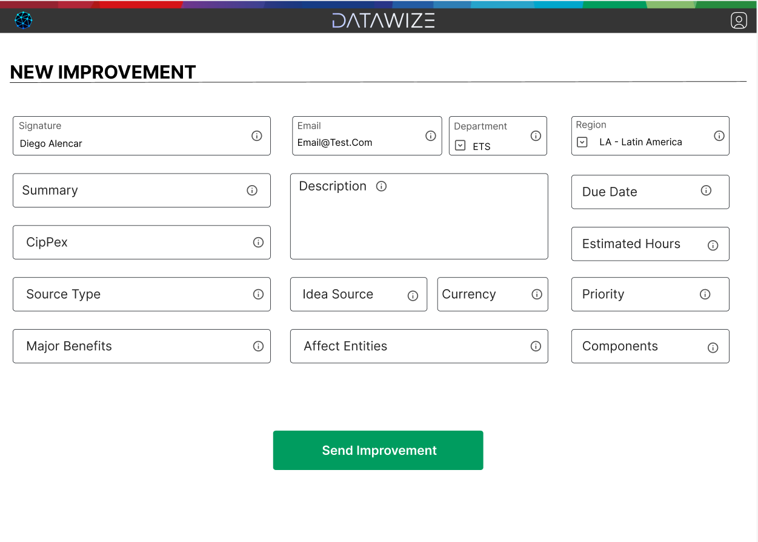
DATAWIZE
THE SOLUTION:

Slide 8
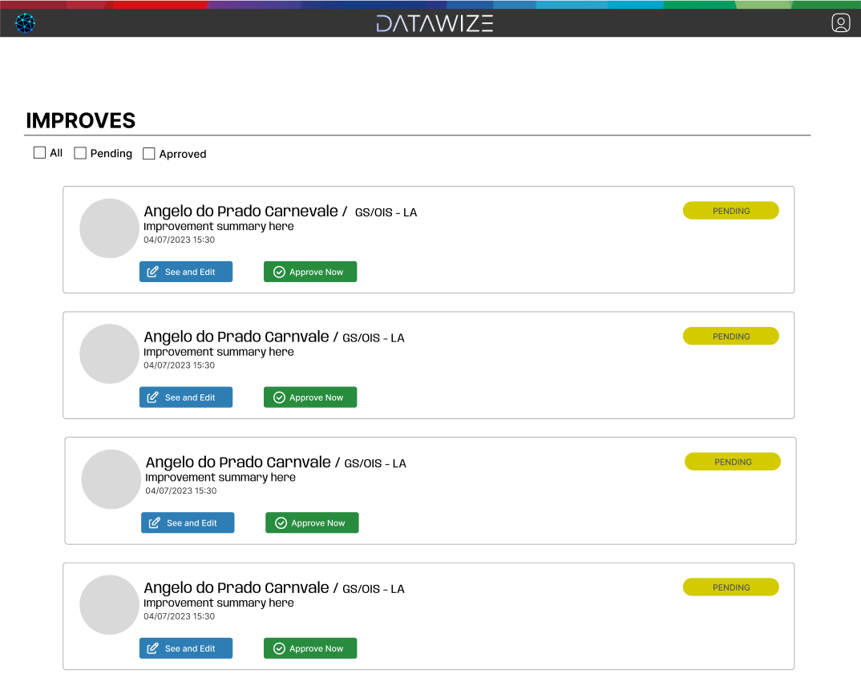
DATAWIZE
THE SOLUTION:

Slide 9





DATAWIZE
THE SOLUTION:
Tools

Slide 10


DATAWIZE
THE MARKET:
Impact
480 hours
120 hours
around R$38.000,00 for the creation and maintenance of the issues
around R$9.500,00 just for the creation of the issues
75% savings

Slide 11




DATAWIZE
THE MARKET:
Potential

Slide 12

DATAWIZE
THE COMPETITION:
Differentiators
Developed
#LikeABosch

Slide 13








DATAWIZE
THE FUTURE:
Next steps

Slide 14




DATAWIZE
Do you have any doubts?
DATAWIZE
@datawize
Contact us!
github.com/datawize-ets
ETS
@ets
ct67ca@br.bosch.com

Slide 15
DATAWIZE

